Slide 1
Exercise Tracking System
Group Number 5

Slide 2
Motivation
Comprehensive Physical and Mental Benefits using workouts.
Tracking exercise counts and calories burned is essential for monitoring and motivating individuals to achieve their fitness goals

Slide 3
Introduction
Propose an exercise tracking system,designed to monitor and analyze an individual’s physical activities,accurately detects the type of exercise being performed, keep track of the repetitions(or counts), and provide real-time data on total calories burnt during workout
Our exercise tracking system uses various sensors and technologies to monitor and record your physical activity and health-related data, and tracking our fitness progress,set goals and make informed decisions about your fitness goals effectively and efficiently.

Slide 4
Introduction
Key Features and Functions:
1.Exercise Recognition
2.Repetition Tracking
3.Calorie Calculation
4.Workout History
5.Personalized Recommendations.

Slide 5
Objectives
Create a robust predictive system that utilizes key parameters obtained by sensors to assess the type of exercise and total calories burnt during workout.
Achieve a high level of accuracy in classifying the type of exercise and its count
Enable real-time or near-real-time assessment of the kind of exercise the person is doing, allowing for timely decision-making regarding their fitness goals.

Slide 6
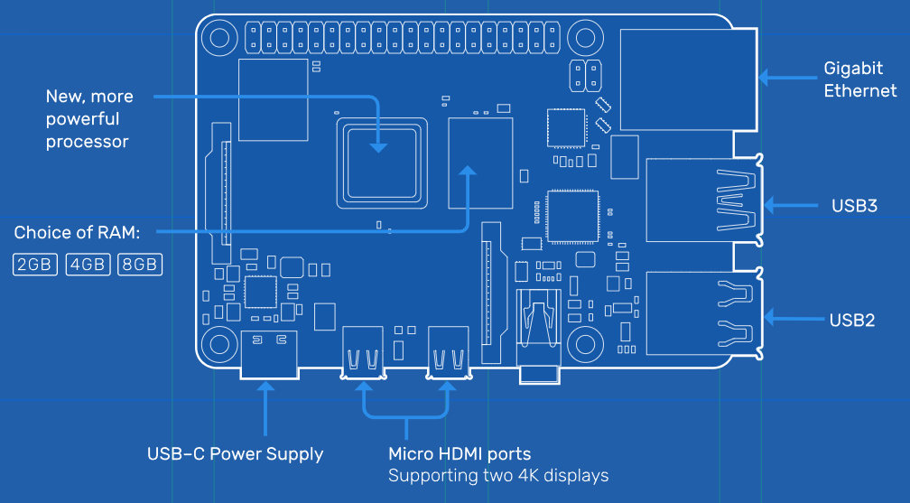
Hardware Components
LSM9DS1 (9 axis IMU)
APDS-9960 (Digital proximity, Ambient light, RGB, and Gesture Sensor)
Raspberry Pi 4
This controller consist of inbuilt embedded module which we are using:
Bluetooth 5.0
Image source: https://assets.raspberrypi.com/static/blueprint-labelled-97975f4b1159239a8e248d180be87e3e.svg

Slide 7
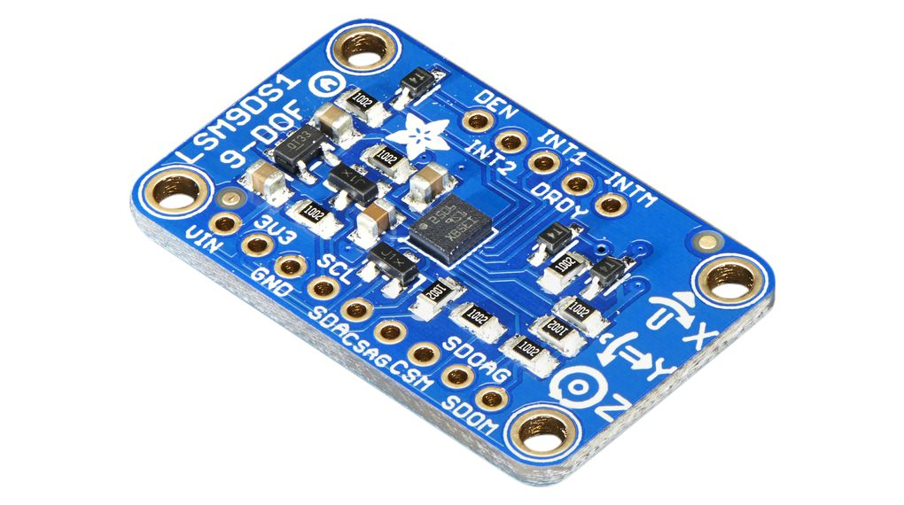
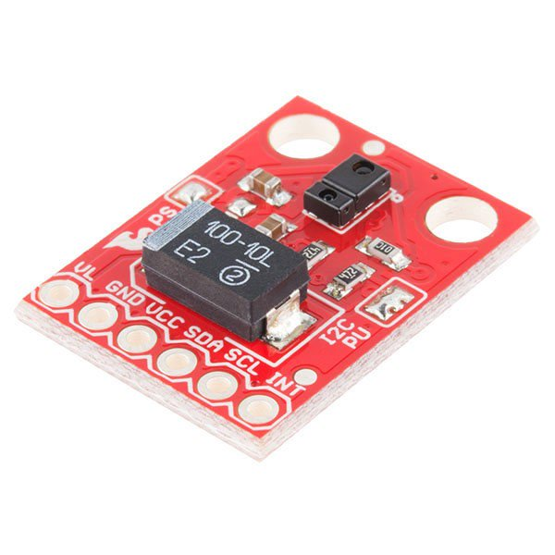
Sensors Used
LSM9DS1 (9 axis IMU):
The LSM9DS1 is a system-in-package featuring a 3D digital linear acceleration sensor, a 3D digital angular rate sensor, and a 3D digital magnetic sensor.
APDS-9960 Sensor:
It is primarily designed for gesture recognition and proximity sensing.
Orientation tracking
Gesture recognition

Slide 8
IoT data collection,cloud training and Deployment
By using Arduino collect the data from the sensors.
Send the data from Arduino to Raspberry pi through serial communication.
By using Raspberry Pi’s wifi or Ethernet to send the data to cloud.
On cloud we will run our ML model to predict the Type of exercise by using various algorithms.
We will deploy the trained model in UI to get real time data.

Slide 9
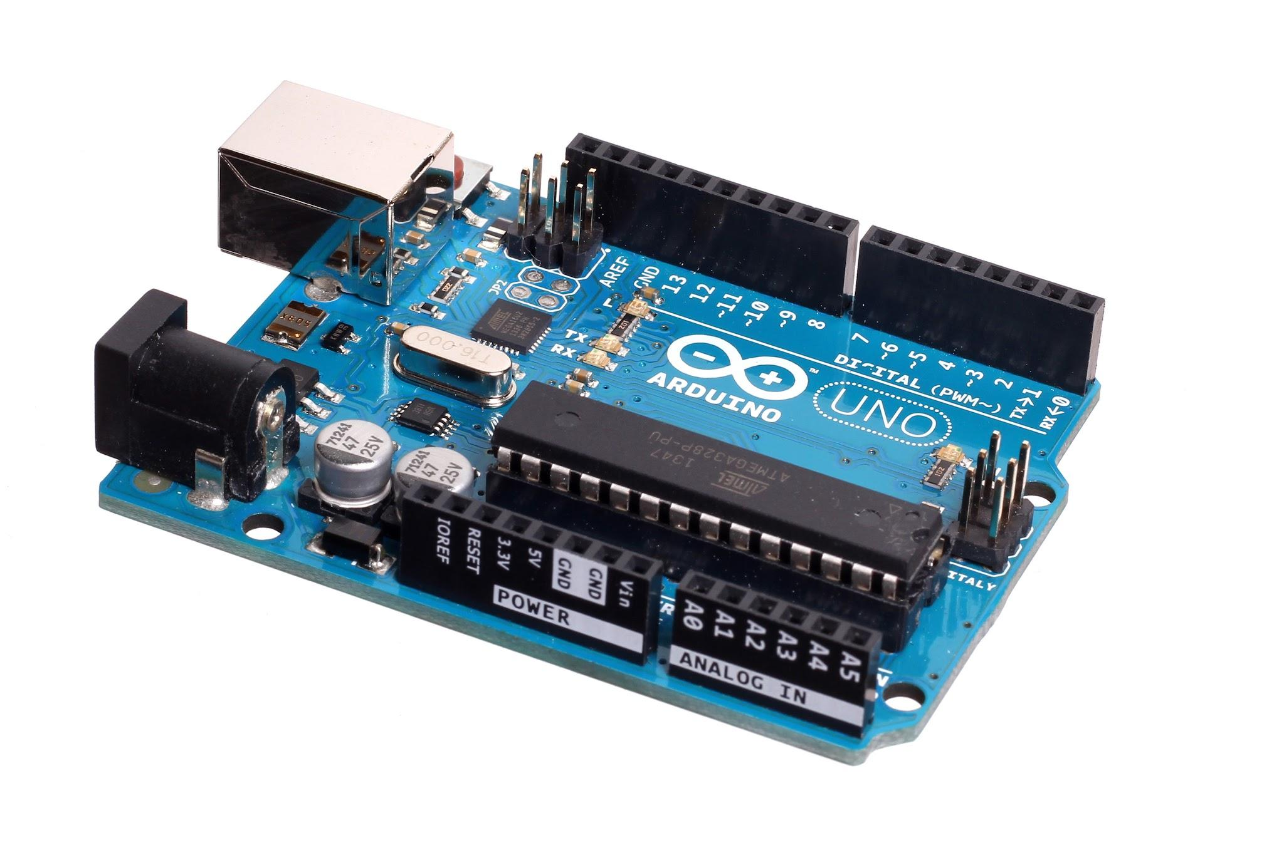
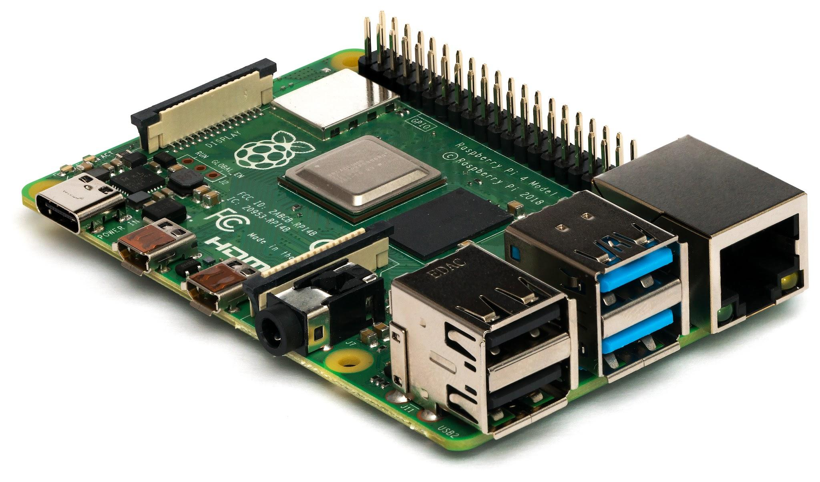

Sensor 1
Sensor 2
ML model
.
.
.
Controller
Raspberry pi
Cloud
UI
Sensor n

Slide 10

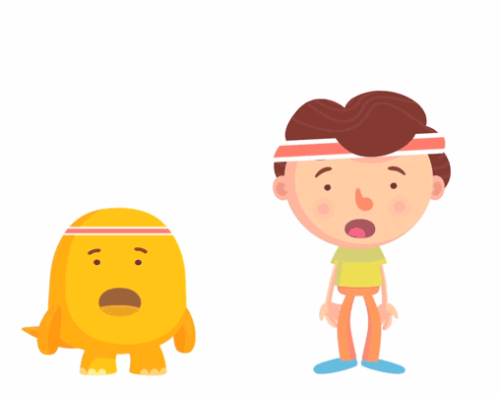


Machine Learning
Determining the type of exercise based on accelerometer readings
Why Machine Learning?
-decision-making
-complex, multidimensional data
Features (Input Variables):
IMU sensors data
Target Variable (Output):
(Type of exercise with count)
Pushups
Squats
Crunches
Lunges
Jumping Jacks

Slide 11
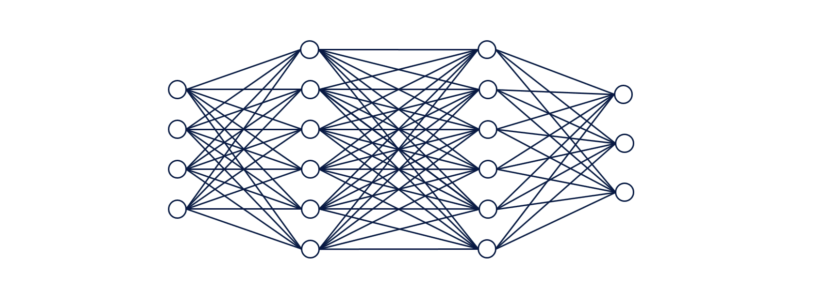
Machine Learning
Neural Network:
Input Layer (Features)
Hidden Layers
-Introduce Non-Linearity
Output Layers
Unsupervised ML Algo: (e.g. Kmeans)

Slide 12
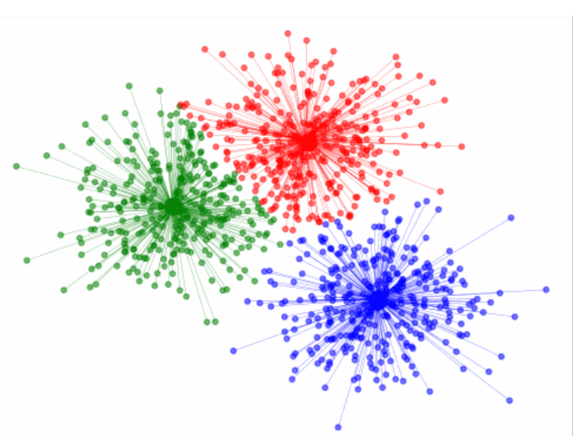
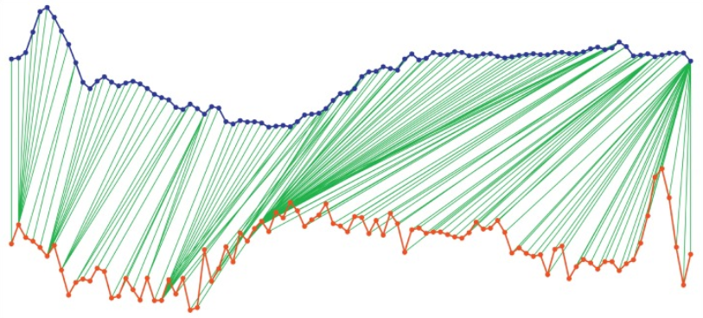
Challenges
Portable device
Different patterns and rhythms
Anomalies in data
K-means clustering
Dynamic Time Warping
Thresholding

Slide 13
Testing
Time based labelled sets
Verification against the outputs given from our model
E.g. 3 pushups and 1 squat vs 4 pushups
Actual data | Timeframe | Prediction | Accuracy
4 pushups | 10 s | 3 pushups, 1 squat | 75%

Slide 14
Timeline
Sept First week
24-30 sept
5-10 oct
15-20 Oct
25-30 Oct
Upto 10th Nov
Start of the Project
Training ML models
Testing
UI Development
Integrating Sensors and controller
Data Collection, preprocessing and storage

Slide 15
Thank You

